Slide 1

Machine Learning
Lecture 1
Dr. Muhammad Kamran Malik

Slide 2
What is Machine Learning

Slide 3

What is Machine Learning
A subfield of computer science and AI
Learn, make decisions and prediction from data.
Enables computers to act and make data–driven decision rather than being explicitly programmed to carry out a certain task.

Slide 4
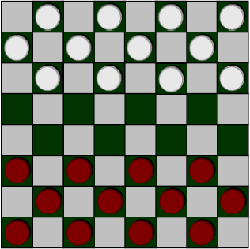
What is Machine Learning
The field of study that gives computers the ability to learn without being explicitly programmed. (Arthur Samuel-1959)

Slide 5
What is Machine Learning
A computer program is said to learn from experience E with respect to some class of tasks T and performance measure P, if its performance at tasks in T, as measured by P, improves with experience E. (Tom Mitchell-1998)
Playing checkers
E = the experience of playing many games of checkers
T = the task of playing checkers.
P = the probability that the program will win the next game.

Slide 6
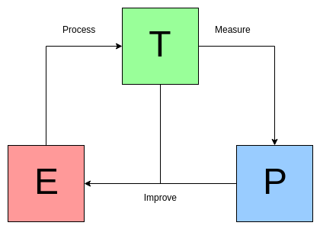
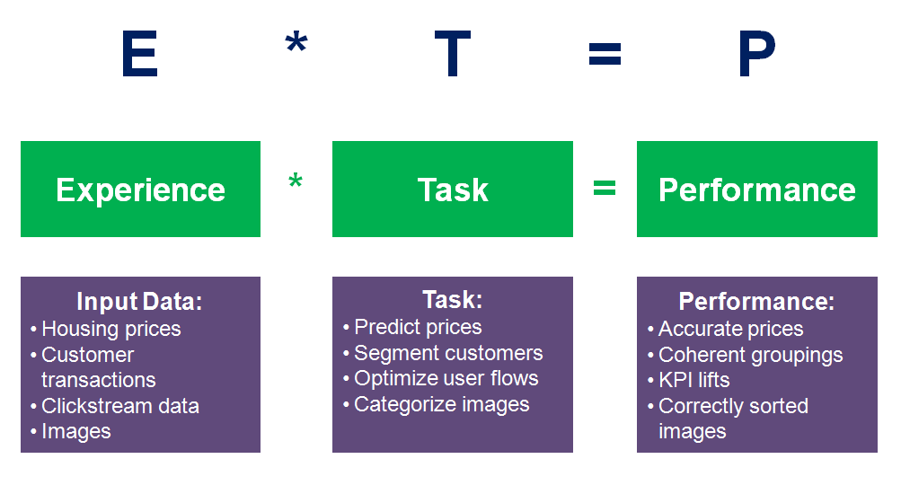
What is Machine Learning

Slide 7
Example: Email Spam Checker
"A computer program is said to learn from experience E with respect to some task T and some performance measure P, if its performance on T, as measured by P, improves with experience E."
Suppose your email program watches which emails you do or do not mark as spam, and based on that learns how to better filter spam. What is the T, E and P in this setting?

Slide 8
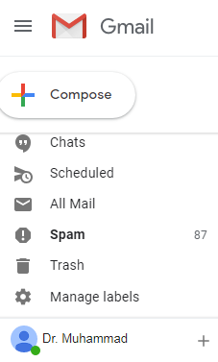

Slide 9
Example: Email Spam Checker
"A computer program is said to learn from experience E with respect to some task T and some performance measure P, if its performance on T, as measured by P, improves with experience E."
Suppose your email program watches which emails you do or do not mark as spam, and based on that learns how to better filter spam. What is the task T in this setting?
Classify emails as spam or not spam.
Watching you label emails as spam or not spam.
The number (or fraction) of emails correctly classified as spam/not spam.
None of the above, this is not a machine learning algorithm.
Notes:
Classify emails as spam or not spam. (Task T)
Watching you label emails as spam or not spam. (Experience E)
The number (or fraction) of emails correctly classified as spam/not spam. (Performance P)

Slide 10
When Machine Learning?
Learning is used when:
Human expertise does not exist (navigating on Mars),
Humans are unable to explain their expertise (speech recognition, time series analysis)
Solution changes in time (routing on a computer network)
Solution needs to be adapted to particular cases (user biometrics)
Data is Big Data (Volume, Velocity, Variety)

Slide 11
Q & A

Slide 12
Machine Learning Applications

Slide 13
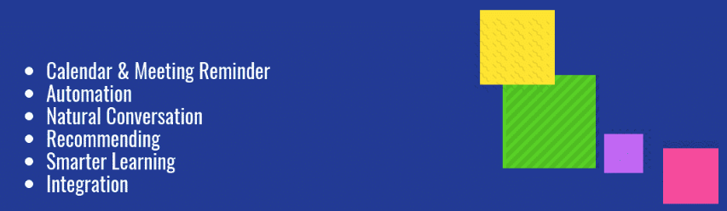
Machine Learning Applications (Virtual Personal Assistant)

Slide 14
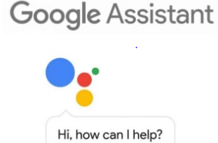
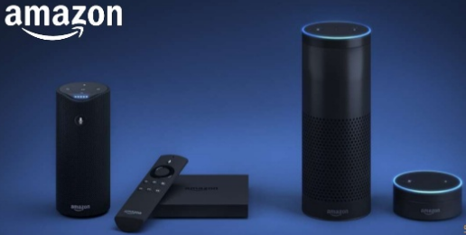



Machine Learning Applications (Virtual Personal Assistant)

Slide 15
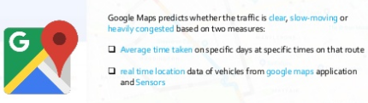
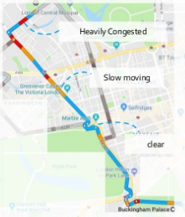

Machine Learning Applications (Traffic Prediction)

Slide 16
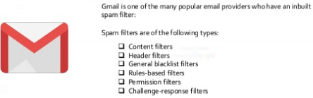
Machine Learning Applications (Email Spam Filtering)

Slide 17

Machine Learning Applications (chatbots)

Slide 18
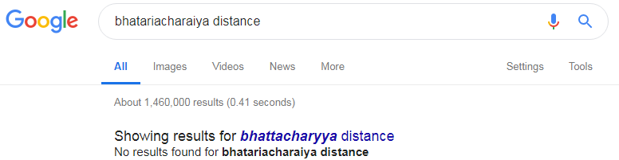
Machine Learning Applications (Search Engine Result Refining)

Slide 19

Machine Learning Applications (Online Fraud Detection)

Slide 20

Machine Learning Applications (Stock Market Trading)

Slide 21
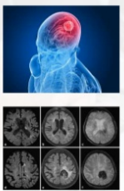
Machine Learning Applications (Assistive Medical Technology)

Slide 22

Machine Learning Applications (Automatic Translation)

Slide 23

Machine Learning Applications (Automatic Friend Tagging suggestions)

Slide 24

Machine Learning Applications (Alt Tags)

Slide 25


Machine Learning Applications (Recommendation Systems)

Slide 26
Machine Learning Applications
Autonomous Cars (TESLA)
Face Recognition app (Iphone)
Moley (The Robotic Chef)
KUKA (Robotic Automation)

Slide 27
Q & A

Slide 28
Machine Learning Process Lifecycle

Slide 29
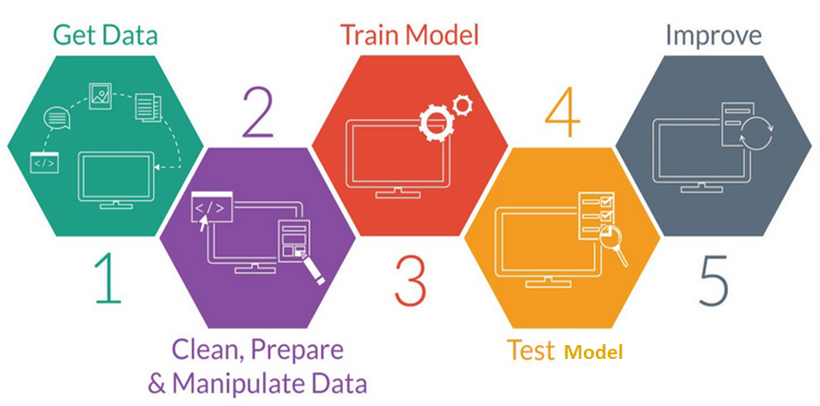
Machine Learning Process Lifecycle
Notes:
ML is a complex process and it touches all aspects of data in the enterprise. Machine learning algorithms learn from data. It is critical that you feed them the right data for the problem you want to solve. Even if you have good data, you need to make sure that it is in a useful scale, format and even that meaningful features are included.
The actual data preparation process is three step as follows:
Step 1: Data Selection: Consider what data is available and sources must be identified, what data is missing and what data can be removed.
Step 2: Data Preprocessing: Organize your selected data by formatting, cleaning and sampling from it.
Step 3: Data Transformation: Transform preprocessed data ready for machine learning by engineering features using scaling, attribute decomposition and attribute aggregation
In summary, the process of improving results involves:
Algorithm Tuning: where discovering the best models is treated like a search problem through model parameter space.
Ensemble Methods: where the predictions made by multiple models are combined.
Extreme Feature Engineering: where the attribute decomposition and aggregation seen in data preparation is pushed to the limits.

Slide 30
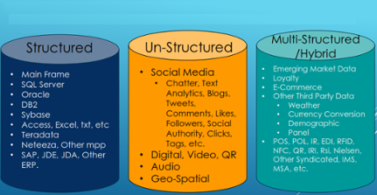

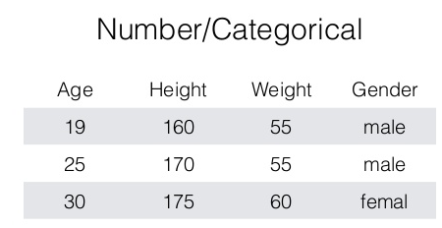
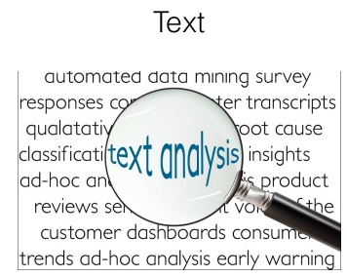
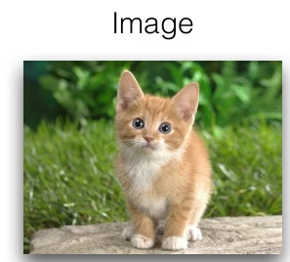
Get Data
Notes:
Data sets differ in a number of ways. For example, the attributes used to describe data objects can be of different types-quantitative
or qualitative--and data sets may have special characteristics; e.g., some data sets contain time series or objects with explicit relationships to one another.
Not surprisingly, the type of data determines which tools and techniques can be used to analyze the data. Furthermore, new research in data mining is
often driven by t he need to accommodate new application areas and their new types of data.

Slide 31
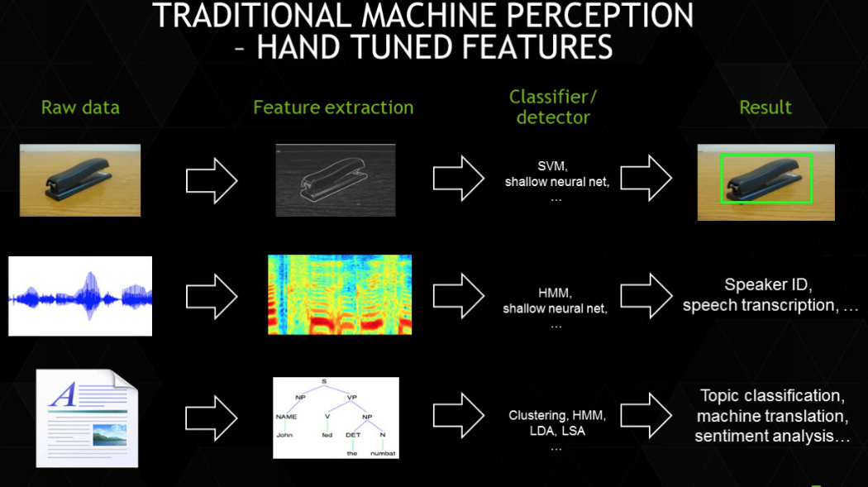
Cleaning and preparing (Features)
Notes:
Feature extraction is automatic (without human intervention) and multi-layered. The power of deep learning is not in its classification skills, but rather in its feature extraction skills.
Feature engineering involves finding connections between variables and packaging them into a new single variable is called. Deep Learning performs automated feature engineering. Automated feature engineering is the defining characteristic of Deep Learning especially for unstructured data such as images.

Slide 32
Train Model (Model Building – a search problem)
Which type of model is most suitable for this data?
(a)
(b)
Dataset - 1
Dataset - 2
(c)
(d)

Slide 33


Test Model (Evaluation)
Given prediction results, which model is better?
Model-1 | Predicted
Actual
 | 100 | 50 | 50
 | 1000 | 100 | 900
Accuracy = 950 / 1100 = 86.4%
Model-2 | Predicted
Actual
 | 100 | 0 | 100
 | 1000 | 0 | 1000
Accuracy = 1000 / 1100 = 91%
33

Slide 34
Q & A

Slide 35
Types of Machine Learning Algo

Slide 36
Types of Machine Learning Algorithms
Machine Learning
Unsupervised Learning [Data Driven]
Reinforcement Learning [Environment Driven]
Supervised Learning [Task Driven]
Regression
Classification
Clustering
Dimensionality Reduction
Fully observable environment
Partially observable environment

Slide 37
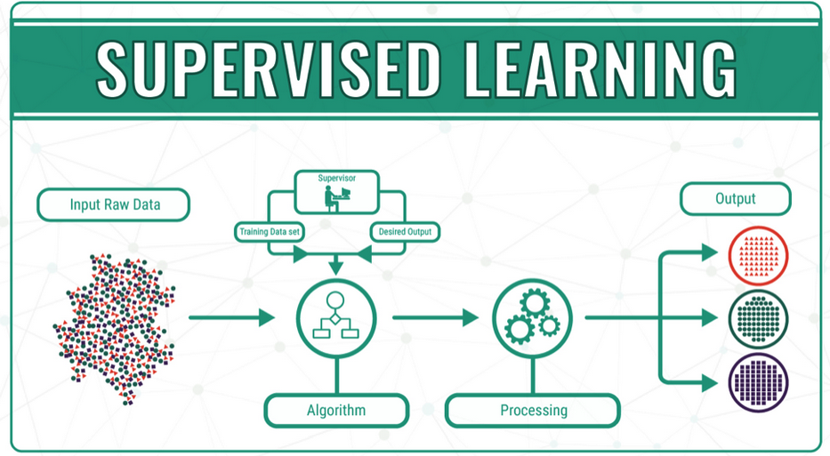
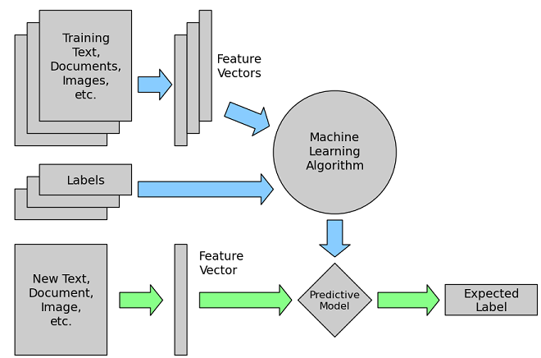
Supervised Learning
Notes:
The main goal in supervised learning is to learn a model from labeled training data that allows us to make predictions about unseen or future data.
OR
supervised learning where the goal is to predict the categorical/continuous class labels of new instances, based on past observations.
In unsupervised learning, there is no label or target attribute. A typical example would be clustering data based on learned patterns.

Slide 38
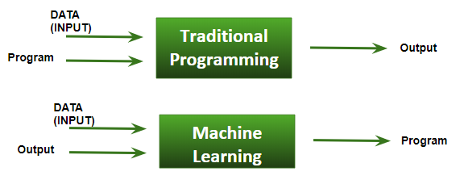
Supervised Learning

Slide 39
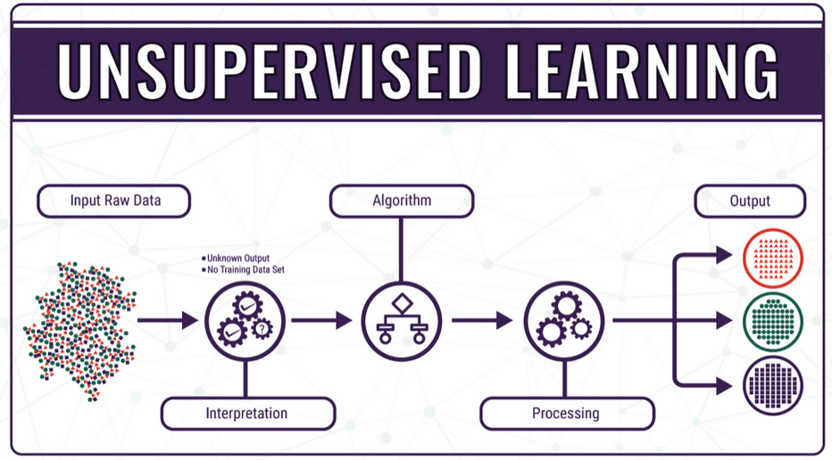
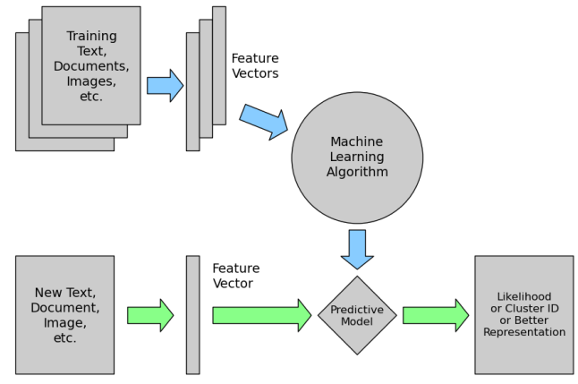
Unsupervised Learning
Notes:
The main goal in supervised learning is to learn a model from labeled training data that allows us to make predictions about unseen or future data.
OR
supervised learning where the goal is to predict the categorical/continuous class labels of new instances, based on past observations.
In unsupervised learning, there is no label or target attribute. A typical example would be clustering data based on learned patterns.

Slide 40
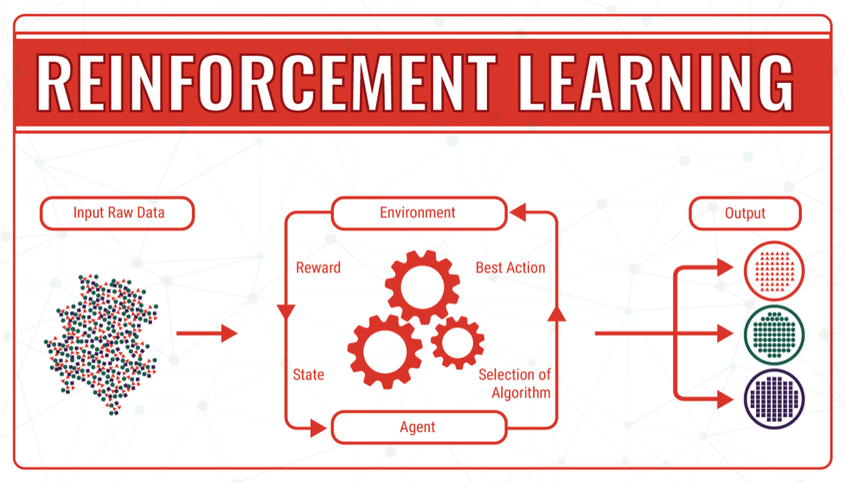
Reinforcement Learning
Notes:
In Reinforcement Learning, an ‘Agent’ acts in an ‘Environment’ and receives positive or negative feedback. Positive feedback tells an agent that it has done well, and agent proceeds on similar plan/action. Negative feedback tells an agent that it has done something wrong, and should change it’s course of action. The agent and the environment are software/programmed implementations. The core of reinforcement learning is building an agent (or agent’s behaviour in some way) that learns to successfully accomplish a specific task in an environment.

Slide 41

Machine Learning Extended

Slide 42
Q & A

Slide 43
Clustering / Classification / Regression

Slide 44
Clustering / Classification / Regression ??
Given data about the size of houses on the real estate market, try to predict their price.
Given a picture of a person, we have to predict their age on the basis of the given picture
Given a patient with a tumor, we have to predict whether the tumor is malignant or benign.
Building a system that predicts whether the house "sells for more or less than the asking price."
Take a collection of 1,000,000 different genes, and find a way to automatically group these genes into groups that are somehow similar or related by different variables, such as lifespan, location, roles, and so on.

Slide 45
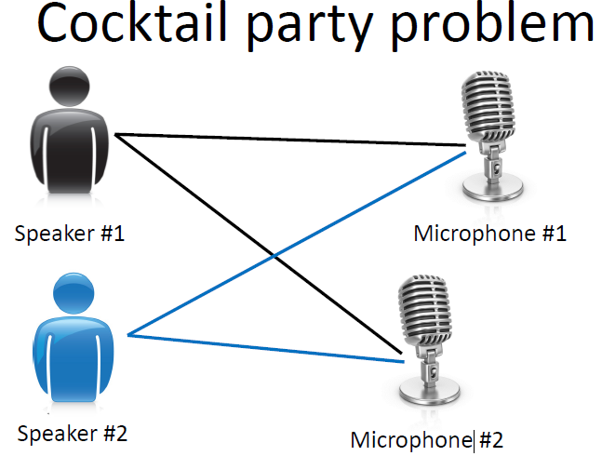
The "Cocktail Party Algorithm",
allows you to find structure in a chaotic
environment. (i.e. identifying individual
voices and music from a mesh of
sounds at a cocktail party).

Slide 46


Slide 47
